Slide 1
More on e20!

Slide 2
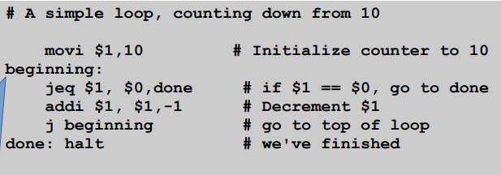
Labels!
Labels are names we give to addresses in memory → we can use them as immediate values
Value of a label is the memory address where it is defined
What is the value of beginning? What about done?
Why would we use these instead of the numeric address of an instruction?

Slide 3
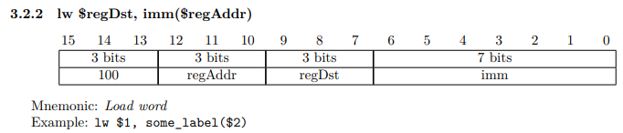
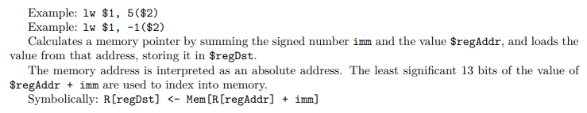
Load Word
Move value from memory address imm+regAddr into destination register

Slide 4
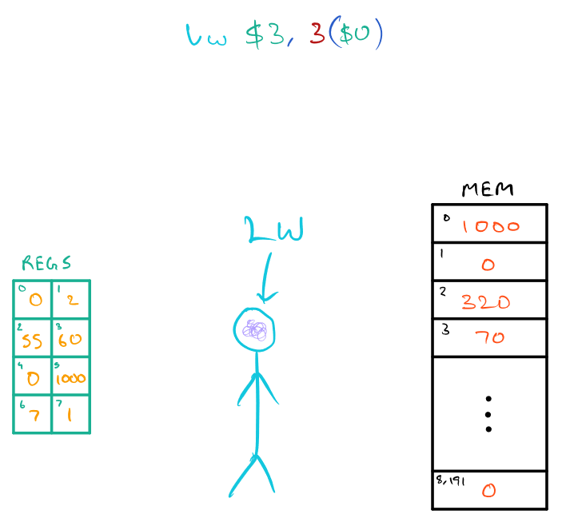
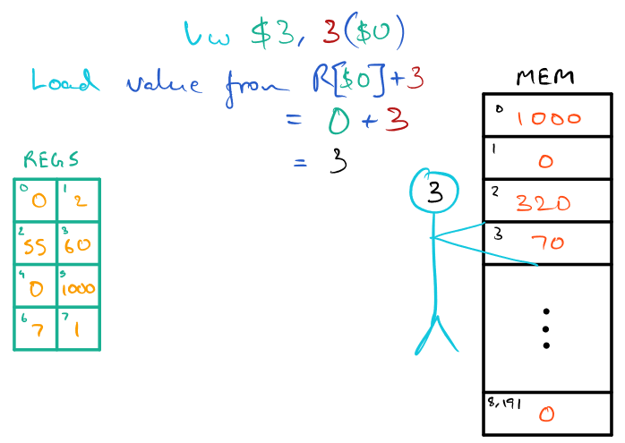
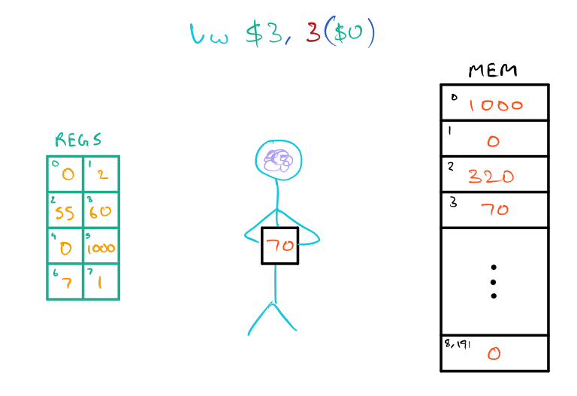
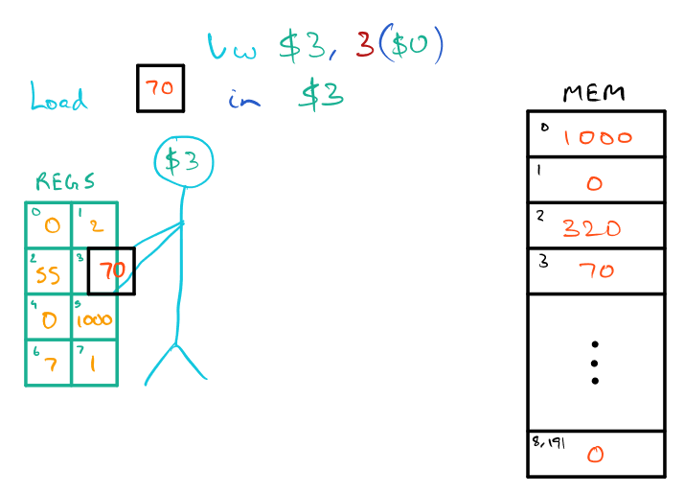
Move value from memory address imm+regAddr into destination register

Slide 5
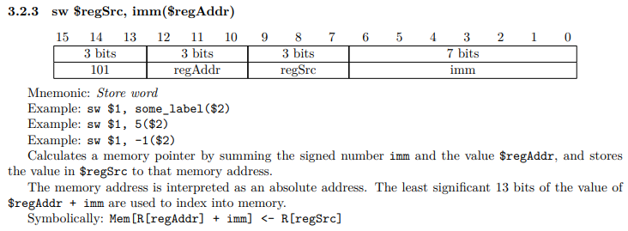
Store Word
Move value from source register into memory address imm+regAddr

Slide 6
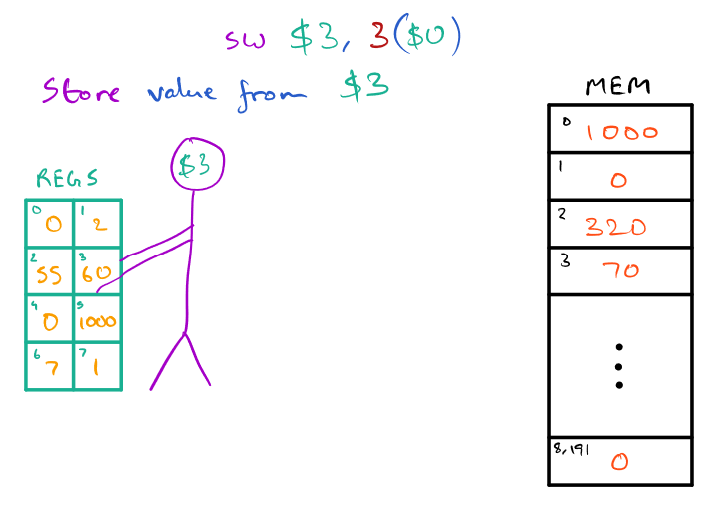
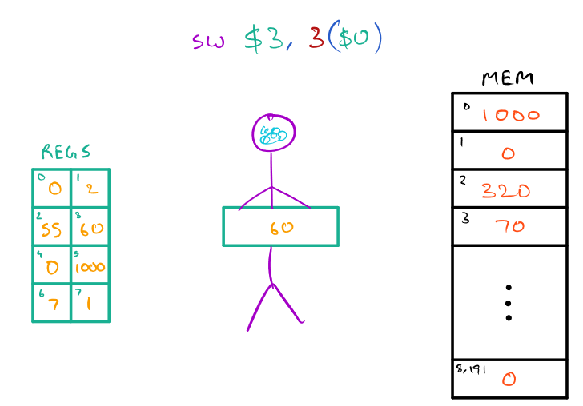
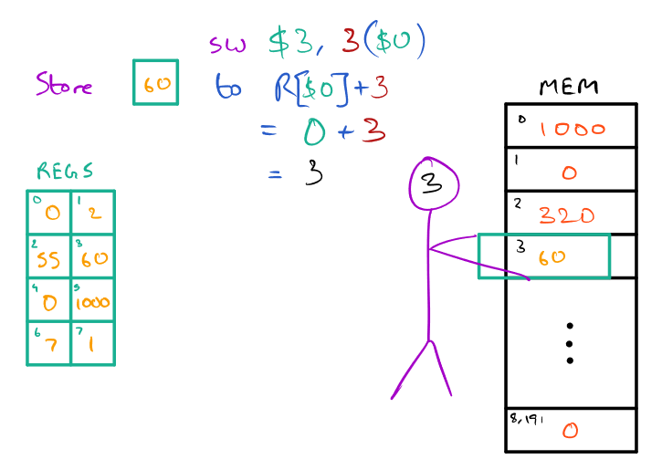
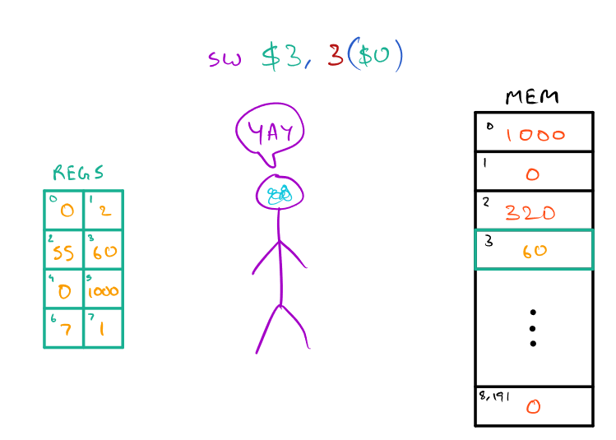
Move value from source register into memory address imm+regAddr

Slide 7
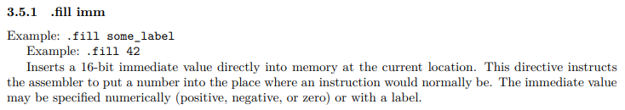
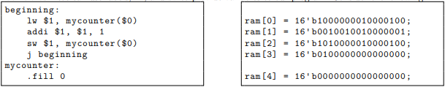
.fill
.fill is an assembler directive
Commands to assembler, not processor instructions
When instruction is converted to machine code using the assembler, the immediate value is stored in the memory location as a 16-bit binary value

Slide 8
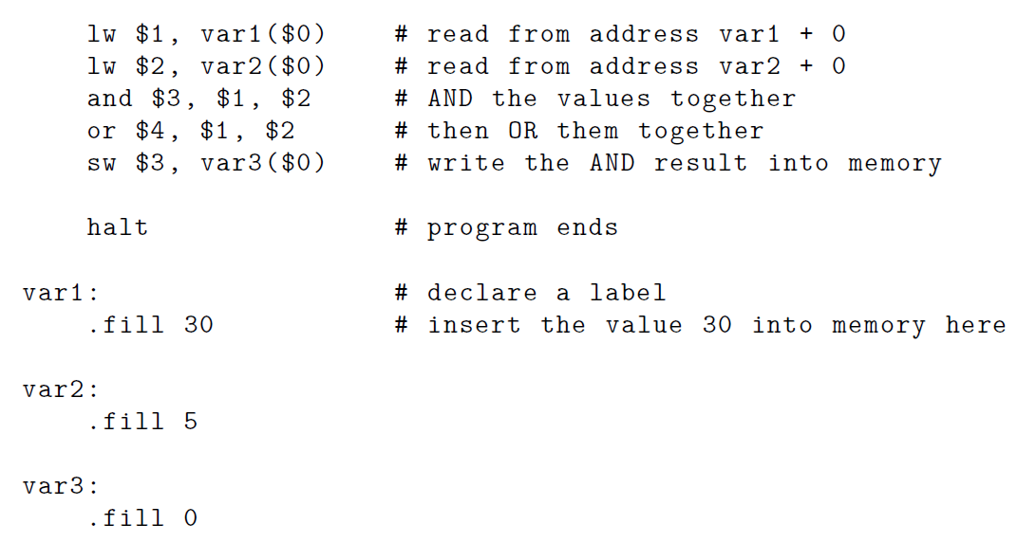
An example with labels, lw, sw, and .fill
ram[0]
ram[1]
ram[2]
ram[3]
ram[4]
ram[5]
ram[6]
ram[7]
ram[8]

